Slide 1
The Memory System
Secondary Storage

Slide 2
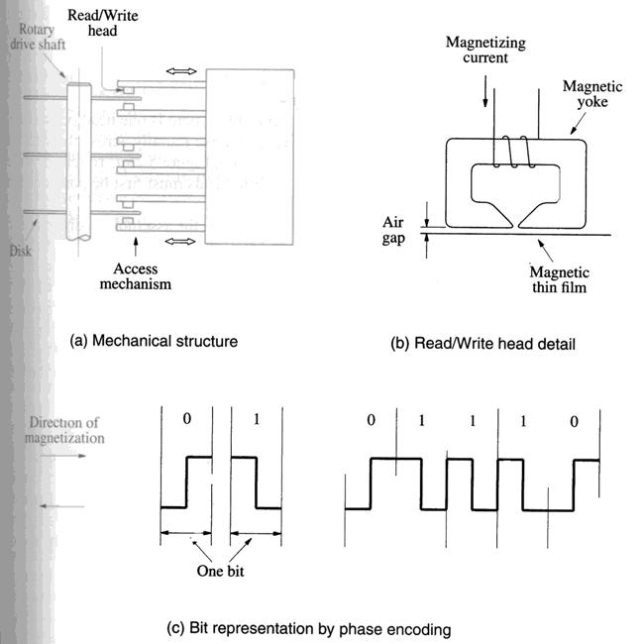
Magnetic Hard Disks

Slide 3
Disk System
3 key parts
Assembly of disk platters – disk
Electromechanical mechanism that spins the disk and moves the read/write heads – disk drive
Electronic circuitry that controls the operation of the system – disk controller

Slide 4
Organization of Data on a Disk
Sector 3, track
n
Sector 0, track 1
Sector 0, track 0
Figure 5.30. Organization of one surface of a disk.

Slide 5
Access Time
Seek time – Time required to move the read/write head to the proper track
Rotational delay (latency time) – Amount of time elapses after the head is positioned over the correct track until the starting position of the addressed sector passes under the read/write head
Disk access time – sum of these two delays

Slide 6
Disk Controller
Processor
Main memory
System bus
Disk controller
Disk drive
Disk drive
Figure 5.31. Disks connected to the system bus.

Slide 7
Disk Controller
Seek
Read
Write
Error checking

Slide 8
RAID Disk Arrays
Redundant Array of Inexpensive Disks
Using multiple disks makes it cheaper for huge storage, and also possible to improve the reliability of the overall system.
RAID0 – data striping
RAID1 – identical copies of data on two disks
RAID2, 3, 4 – increased reliability through parity checking schemes (Parity information on one disk)
RAID5 – parity-based error-recovery(Distributed to all disks)

Slide 9
Optical Disks
(a) Cross-section
Pit
Land
Reflection
Reflection
No reflection
Source
Detector
Source
Detector
Source
Detector
(b) Transition from pit to land
0
1
0
0
1
0
0
0
0
1
0
0
0
1
0
0
1
0
0
1
0
(c) Stored binary pattern
Figure 5.32. Optical disk.

Slide 10
Optical Disks
CD-ROM
CD-Recordable (CD-R)
CD-ReWritable (CD-RW)
DVD(Digital Versatile Disks)
DVD-RAM(Read-writable version)

Slide 11
Magnetic Tape Systems
File
File
mark
File
mark
•
•
•
•
•
•
•
•
7 or 9
bits
File gap
Record
Record
Record
Record
gap
gap
Figure 5.33. Organization of data on magnetic tape.

